Slide 1
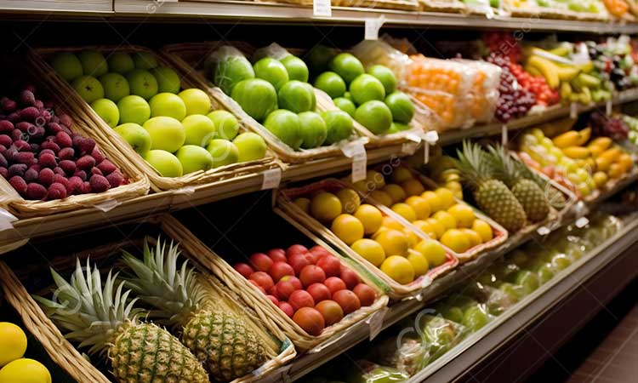
Smart Sorting System
This project focuses on using transfer learning techniques to identify rotten fruits and vegetables. By automating the sorting process, it aims to improve efficiency and accuracy in the agricultural and food industry.

Slide 2




Smart Sorting Transfer Learning for Identifying Rotten Fruits and Vegetables
Branch Name
Track
Team Lead
Team Members
Computer Science and Engineering
P. Narasimha Rajesh,
R. Saideepak,
S. Bhuvana Satya
Artificial Intelligence and Machine Learning
Posina Sai Chakra Amrutha Varshini

Slide 3



Project Scenarios
Fresh Shipment Scanning
2
Ensures only fresh produce reaches customers, minimizing waste.
Automating Sorting
Reduces human error and labor intensity, enhancing efficiency.
1
Smart Home Monitoring
3
Alerts users about items nearing spoilage, thus reducing food waste.

Slide 4


Architecture and Prerequisites
Architecture
Prerequisites
The system integrates a model with a Flask application for image analysis.
Users must install Anaconda and several Python packages, including TensorFlow and Flask.

Slide 5


Project Objectives
Understand Deep Learning
Data Preprocessing Knowledge
Develop Data Visualization Skills
Grasp fundamental concepts and techniques.
Learn data transformation techniques.
Enhance abilities for insights analysis.

Slide 6


Project Flow
1
2
3
User Image Selection
Model Processing
Results Display
The user selects an image through the UI.
The model processes the selected image and predicts the outcome.
The results are displayed on the UI for the user to see.

Slide 7
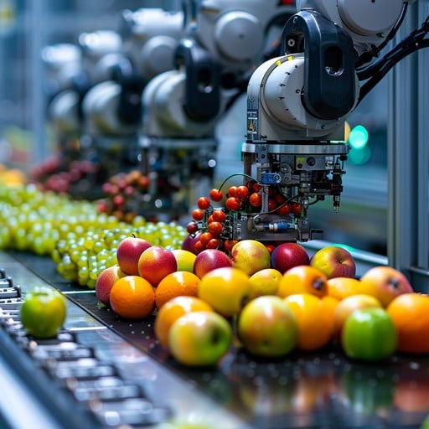

Data Collection and Preparation
1
Dataset
The project utilizes a dataset of 28 classes of fruits and vegetables sourced from Kaggle.
2
Data Visualization
Techniques are employed to visualize and analyze the dataset for better understanding.
3
Data Augmentation
Various transformations are applied to increase the dataset's diversity, aiding model robustness.

Slide 8

Application Development
1
HTML Pages
Three HTML files for user interaction.
2
Flask Integration
Connects the UI to the predictive model.
3
Model Testing
Tests the model's accuracy in identifying produce.

Slide 9
Advancements in Smart Sorting System
The Smart Sorting system demonstrates significant advancements in fruit and vegetable sorting through AI and transfer learning. By automating processes, it enhances efficiency, reduces waste, and improves quality control in the agricultural sector. Future work can expand the model's capabilities and applications.
Efficiency Enhancement
Automates sorting processes to improve efficiency.
Waste Reduction
Significantly reduces waste in the agricultural sector.
Quality Control Improvement
Enhances quality control measures in sorting.

Slide 10
CONCLUSION:
Smart Sorting using transfer learning effectively automates the detection of rotten fruits and vegetables, improving accuracy and reducing manual effort. By leveraging pre-trained models, it ensures faster, scalable, and reliable quality control—helping reduce food waste and enhance supply chain efficiency.

